Slide 1
Software Engineering and Architecture
A bit of Motivation and some hints

Slide 2
Why TDD?
“TDD seems very slow, I need to write all those tests which takes a lot of time, instead of writing production code?”
Yeah… But – your productivity keeps nearly constant !
Productivity = ‘Correct lines of code per hour’
With tests
Without tests
Time

Slide 3
Exercise
You are employed in a company with little Automated Test tradition… Manual tests…
What happens here ? And what happens next?
Productivity = ‘Correct lines of code per hour’
Year 1
Year 2
Without tests
Time

Slide 4
When TDD?
Do I always do TDD?
No! Hacking together a quick Python script to compute SWEA delivery deadlines, or other ‘one-time-tasks’, I just develop using ‘run-and-see-it-work’ (but I always ‘Take Small Steps’)
The first running code is always “Hello my new script” printed!
Testing and TDD is for larger systems with a longer time period…
Sometimes ‘one-time-prototypes’ become real systems
WarStory:
That quick-and-dirty prototype, that actually worked…
Had to spend 14 days putting in tests to get productivity up again!

Slide 5
Why Pair Programming?
Why waste time on two people doing one person’s coding?
SWEA motivation
Get everybody to the keyboard – training is vital
XP motivation
Knowledge sharing and mutual learning
Keep quality high

Slide 6
Mandatory Notes

Slide 7
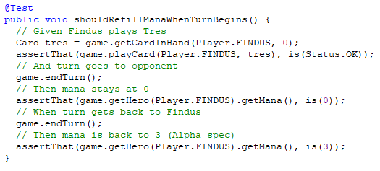
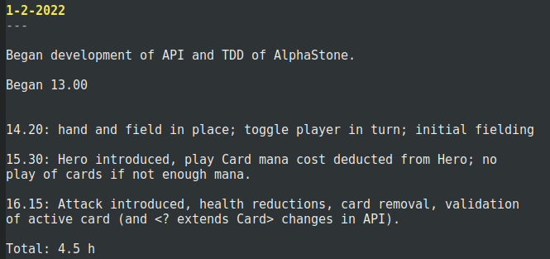
Evident Tests
The ‘GWT’ comments help a lot, I find…
Last year TA’s wanted some guidance so I pulled out ‘TestAlphaStone’ which I wrote in February

Slide 8
Incorrect Assumptions
Producing code means making mistakes, also in the test!
Defects often arise when you have incorrect assumptions
Step 1: Quickly Write a Test
Given game with Dos, Cuatro in Findus’ hand
And Dos is at index 0 in the hand
When I play Dos, Then the field has 3 cards (Uno+Tres already there)
Step 2: Run all tests to see the new one fail
“But the error reported is some weird null pointer / index out of range error?”
15 min later: Aah, Dos had already been played !!!
Red Bar

Slide 9
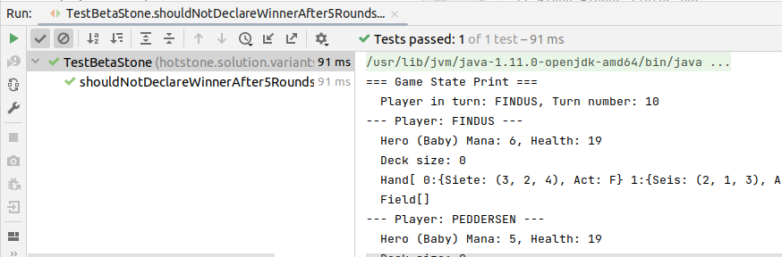
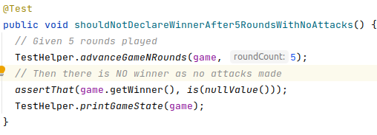
Take Small Steps
Small steps: Ensure your assumptions are correct
Verify that the hand is actually Dos + Cuatro
Helper methods to ‘dump complete game state’
TestHelper.printGameState(game);
Remove the ‘printing’ once your tests runs correctly!
Provided in HotStone Code

Slide 10
What is TDD???
Traditional tests = Quality Assurance Technique
Success:
Tests are constructed to catch defects
TDD tests = Implementation Technique
Success: test cases that drive implementation
Perhaps a few more to show absence of defects
Not a comprehensive quality assurance technique

Slide 11
When Do I Stop?
TDD of the Turn Handling in HotStone
Test 1: Given game, Findus is in turn Fake it
Test 2: Given game, end turn, Pedd. in turn Triangulation
Exercise – Do I need?
Test 3: Given game, 2x end turn, Findus in turn ?
Test 4: 3x end turn, Pedd in turn ?
Test 5: 4x end turn, Findus in turn ?
Test 17: 16x end turn, Findus in turn ?
Exercise – Would it not be clever to do a test like
N from 1..100, Nx end turn; N%2==0 then Findus in turn ?

Slide 12
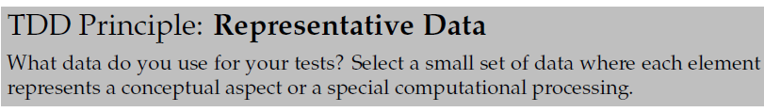
When Do I Stop?
Add test cases until the particular algorithm is complete and correct and then stop!
Overtesting is harmful
Overtesting = same algorithmic production code is tested in numerous different test cases
Exercise: Why is that so, do you think?
Hint: consider that functional requirement changes a bit…

Slide 13
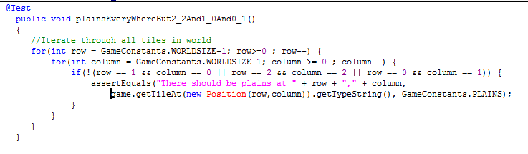
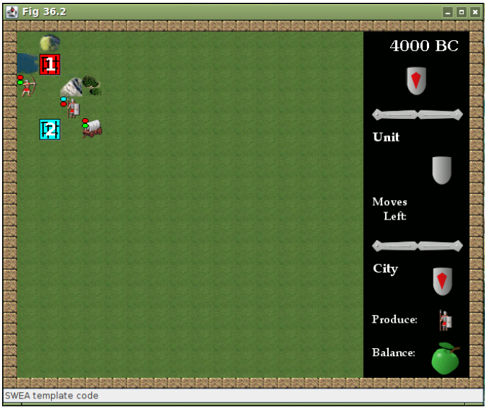
Doing TDD
Evident Tests – make tests easy to understand
Exercise: What is focus here?
Test that everything works? Or
Drive production code into existence?
And – is it Evident ?
Sorry – AlphaCiv example…

Slide 14
Stable Test cases
The more your testcases only use the given Game, Card, Hand interfaces…
The more stable your test cases will be against refactoring/changing inner data structures!
So
game.getCardInHand(FINDUS, 1) ☺
Never, ever things like
((GameImpl) game).internalHandArray[0][1] ☹
Exercise: Why not?

Slide 15
Design Issues
Which data structure should I use?
Anyone you like
Arrays Card[]
Lists List<Card>
Maps Map<Player, Hero>
As there ‘is two of everything’ you will likely combine
List of arrays, or maps of lists, or arrays of lists, or array of arrays, or … Ala Map<Player, List<Card>>
If using arrays, remember ‘ordinal()’ of an Enum
Player.FINDUS.ordinal() == 0
I recommend, however, to avoid raw Java Arrays. Use the collection libraries.
Do the same thing, the same way

Slide 16
Mutation
Who has access to mutation?
Answer: Only Game, it handles the rules of the game…

Slide 17
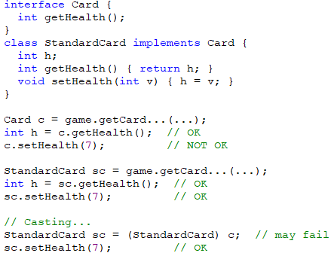
SideBar: For Python People
Java is a type-safe language, meaning types are checked
If an object is of type ‘Card’ only the methods mentioned in that type can be called
If you call other methods; the compiler will refuse!
(Even if the underlying object really does implement that method.)

Slide 18
Those ‘read-only’ interfaces
I stated that try to keep Card, Hero as read only interfaces
That is, they only have accessor methods, no mutator methods
Only ‘getX()’, never a ‘setX(int newValue)’
Why?
Actually it is the ‘Facade’ pattern which we will return to later, but
Main point:
game.getHero(Peddersen).addToHealth(1000);
is not obeying the rules of the game and must be guarded against!
How?
(next slide, please)

Slide 19
Mutating Internal State
Card and Hero should be read-only interfaces
Then how can Game every change, say, hero mana left?
Solution for now:
A) Add mutators to the implementing classes
StandardHero::reduceManaLeft(int byValue)
B) In Game either
Declare by concrete type
List<StandardHero> theHeros;
Or, Use casts when needed
StandardHero hero = (StandardHero) getHero(FINDUS);
Why is this OK?
Well – Game is responsible for mutations and know concrete type

Slide 20
Actually…
… We can find a better solution for this
“Private interfaces”
We will come back to this point later…
SWEA is a course where it is good to know everything in advance
But that is not how learning works, right?

